Slide 1
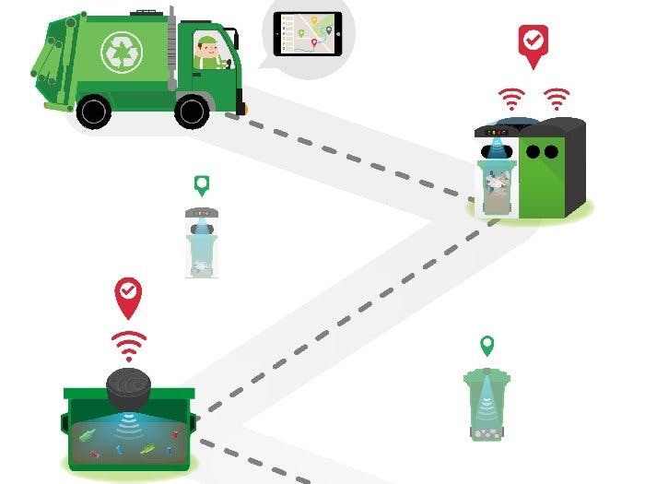
1.LOCATION BASED GARBAGE MANAGEMENT SYSTEM
Mechanism:
We should capture a picture of the filled trash bin and we should update
the location in which place the bin is full in an app or website.
By this we can get a notice from some one that bin is full then it will be
some what helpful to the campus.
For building this app we should use python,
php, Java script etc.
This app can handle both biodegradable and
non-biodegradable wastes
Cost may be 2100rs that also for
publishing app in google play store.
Source: https://www.youtube.com/watch?v=SufuG1l8cqA

Slide 2
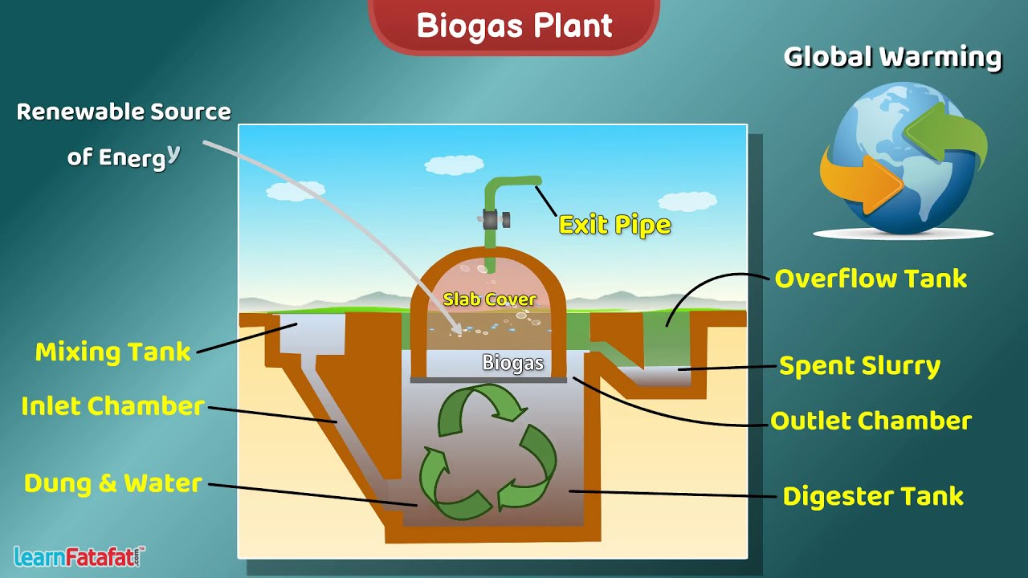
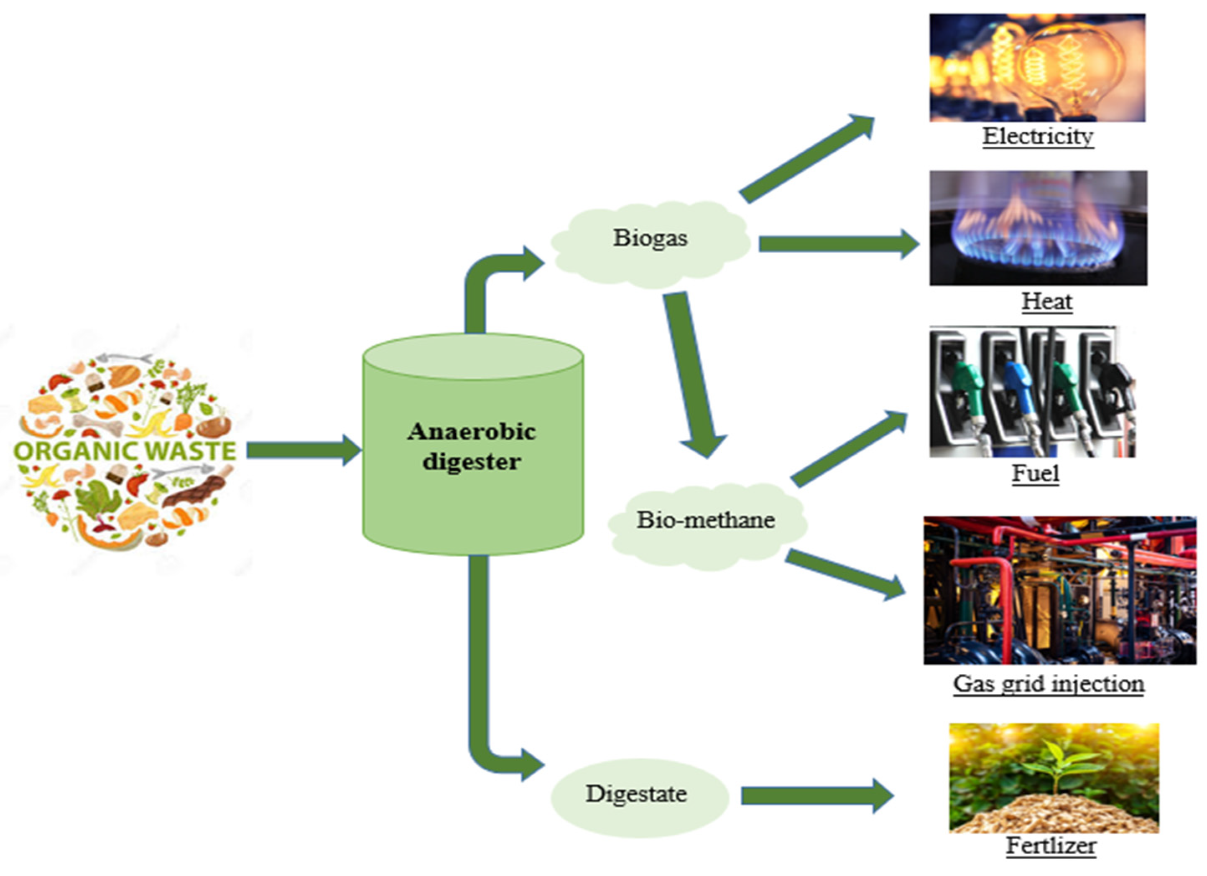
2. BIO GAS
Mechanism:
By decomposing organic waste , cow dung, dry leaves etc methane and carbondioxide is formed which can be flammable. This is called as Bio gas.
Materials needed are sealed drum, pvc pipes, L-joints, tank nipple , f-clamp, tube, hose reel, T-connectors, m-seal , valves etc.
This project mainly concentrates on organic wastes.
Cost may be approximately 10000 rupees.(Source: https://youtu.be/c_Jtl-VhkKI?si=UxSTXFdkw3E2UNyM)

Slide 3
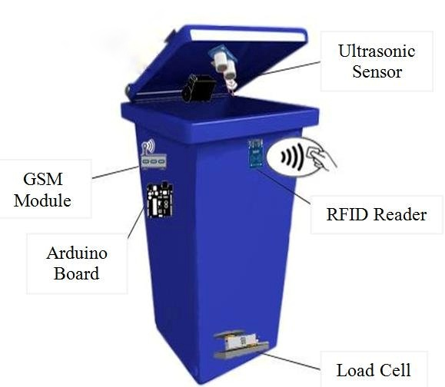
3.SMART BIN
Mechanism:
We will install a device to the dust bins which will detect when
bin is full it will directly sends an alert to the college
management to clean it.
Also it will make buzzer sound after bin is filled.
Essential things are EM310-UDL LoRaWAN ultra sonic
sensor or a normal ultrasonic sensor, batteries ,
connecting wires , buzzer etc.
Cost may be less than approximately 5000 to 6000 rupees.
This project can handle both biodegradable and
non biodegradable wastes
(Source: https://www.youtube.com/watch?v=fgr_UlKBz60)

